Slide 1

Final Project
Peter Zhou, Omar Al Taher, Jen Jen Chen

Slide 2
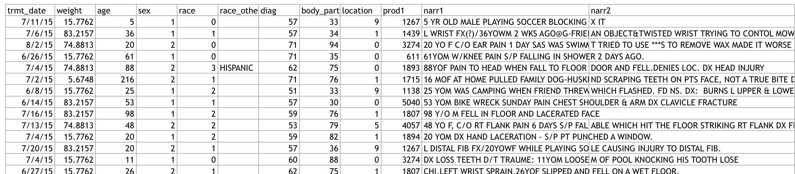
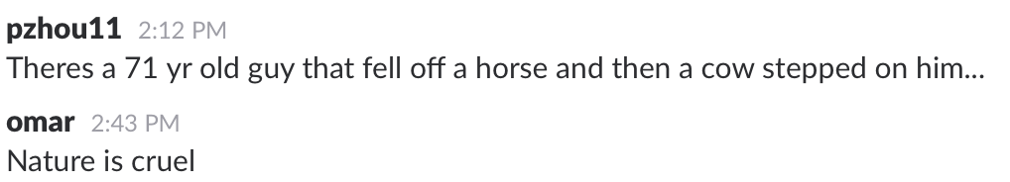
NEISS Data

Slide 3

Questions
Which sex is more prone to injuries?
Emotional states most associated with injury
Types of injuries in different holidays
Household items that pose the largest threat to its inhabitants?
Animal-involved injuries
Injuries under the influence
What is “JUNK IN THE TRUNK”?

Slide 4
Time-related Injuries

Slide 5
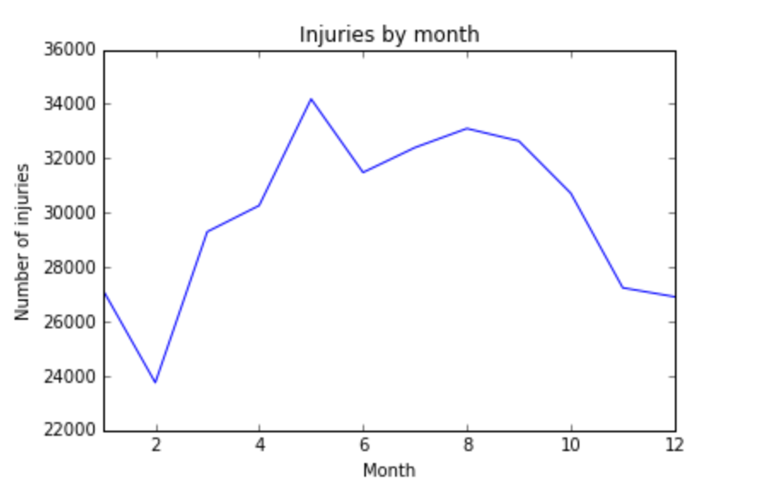
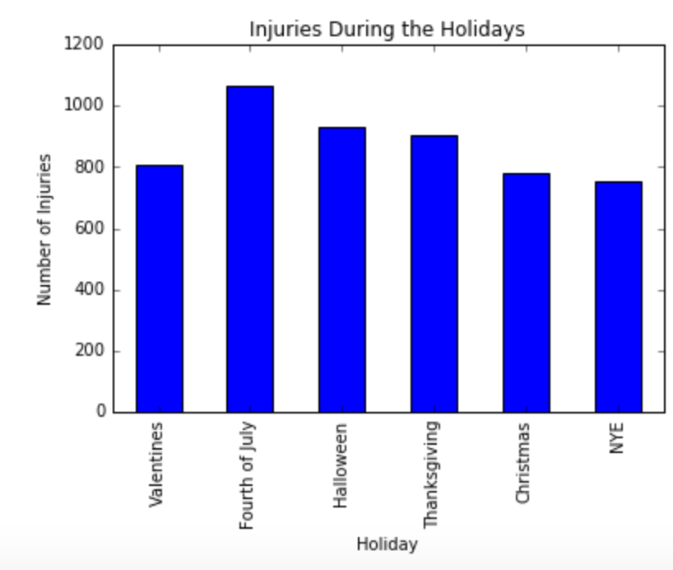

Slide 6
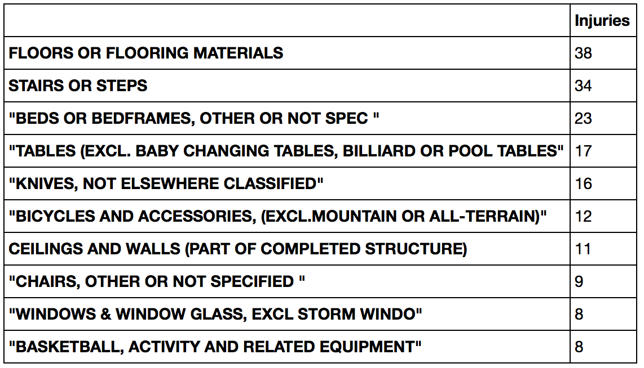
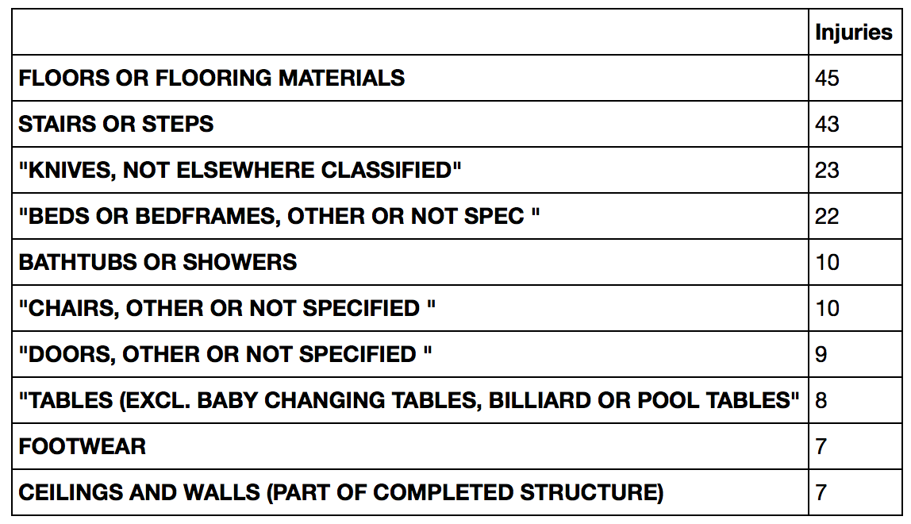
MALE
FEMALE

Slide 7
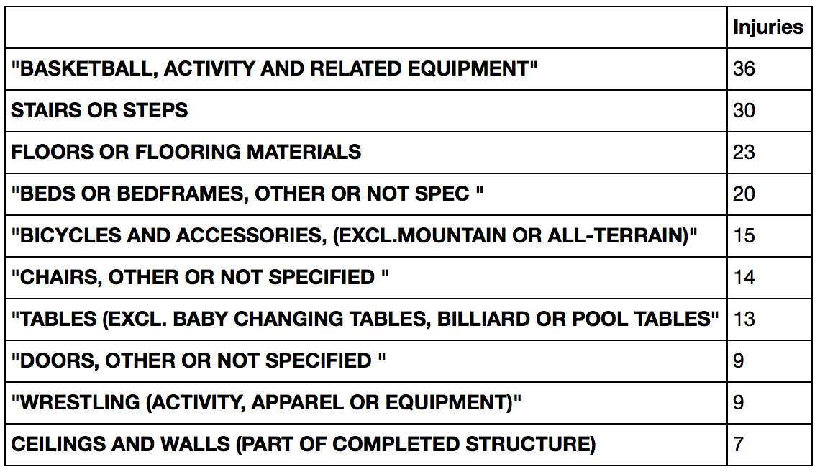
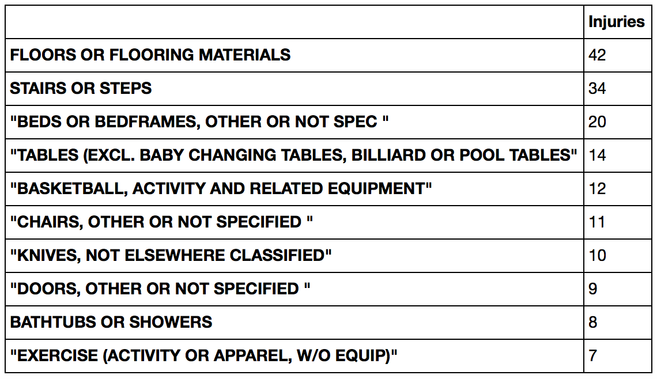
MALE
FEMALE

Slide 8
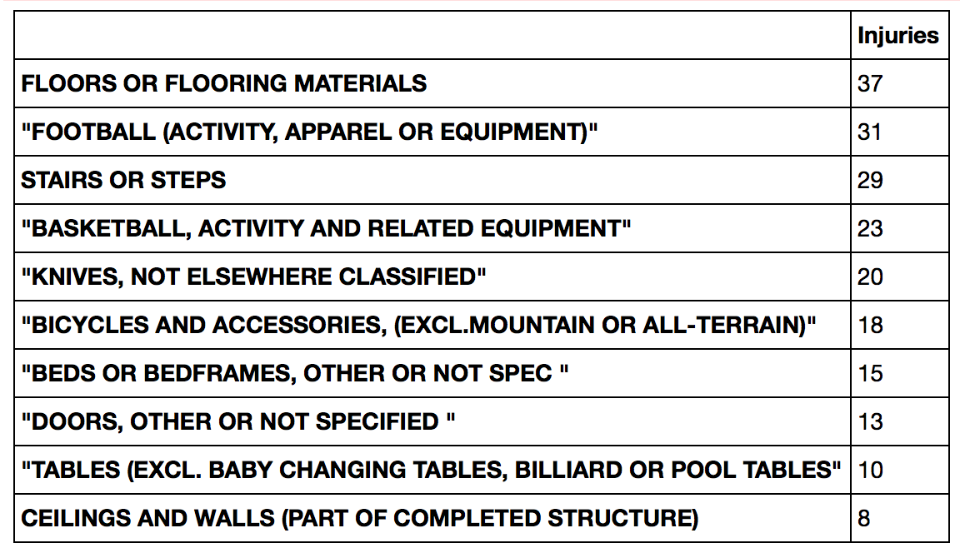
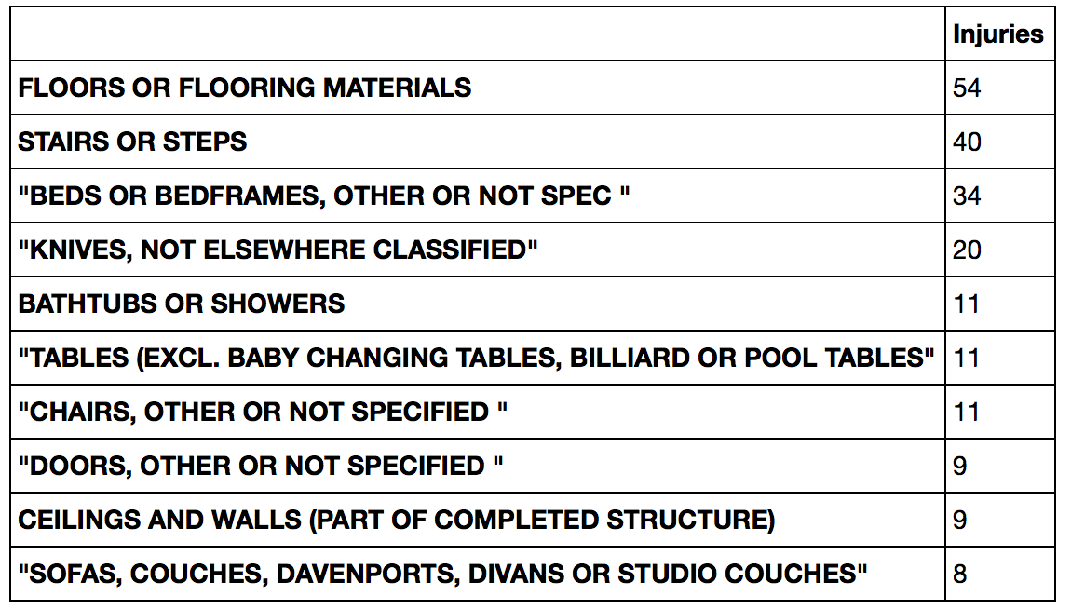
MALE
FEMALE

Slide 9
Injuries under the influence

Slide 10
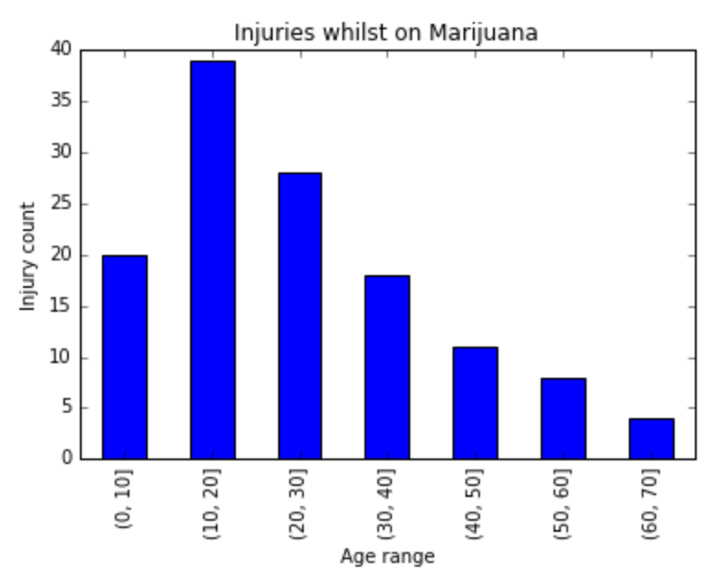
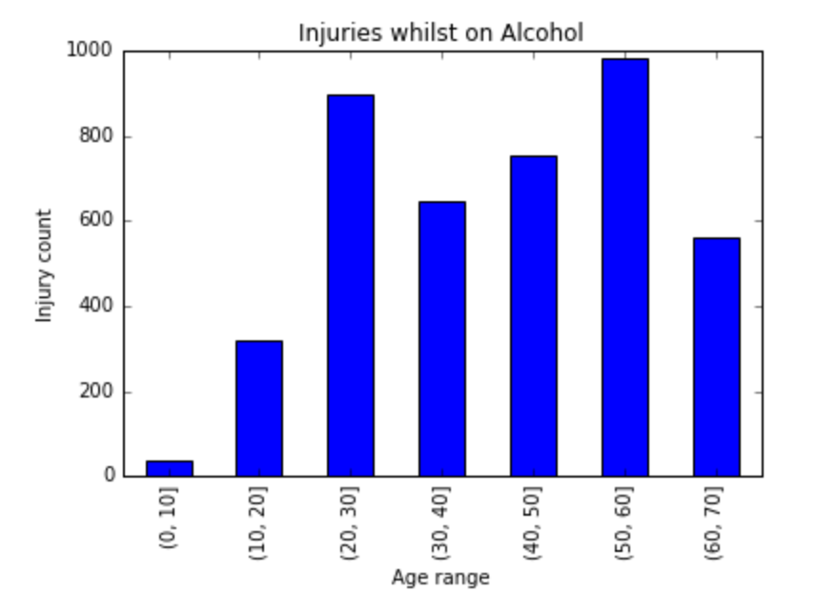
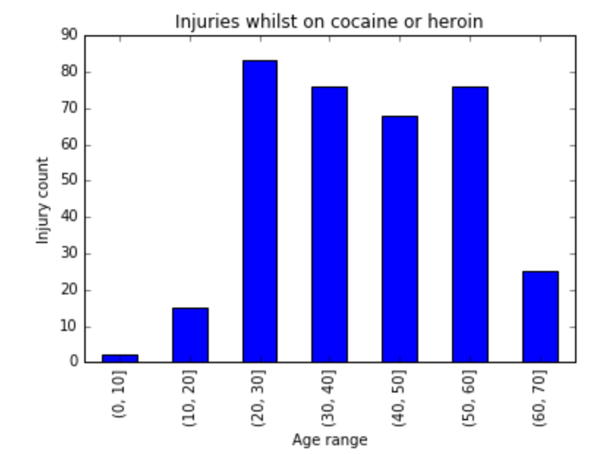

Slide 11
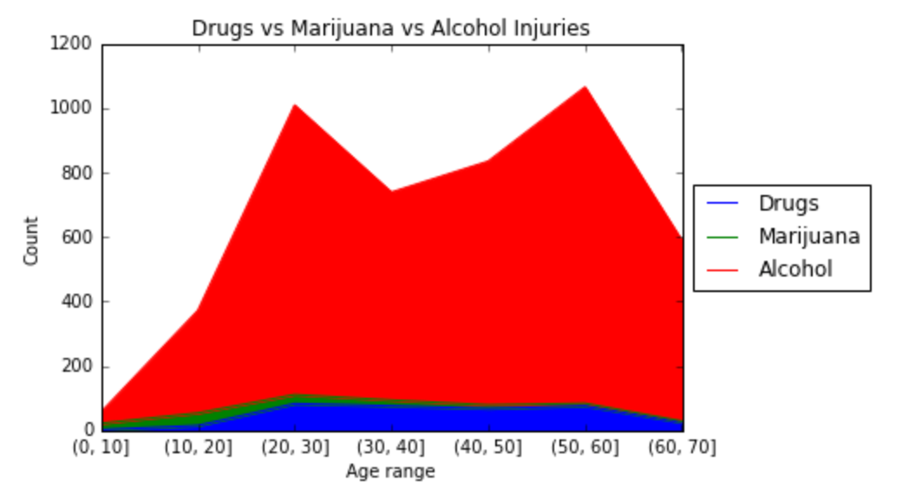

Slide 12
Animal-related injuries

Slide 13
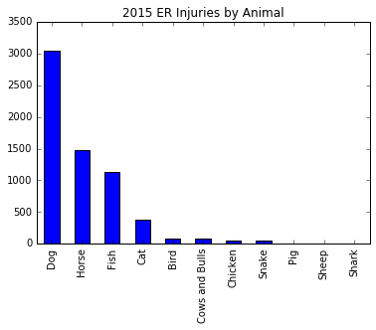
Animal | Count
Dog | 3049
Horse | 1475
Fish | 1125
Cat | 372
Bird | 81
Cows and Bulls | 77
Chicken | 50
Snake | 47
Pig | 6
Sheep | 2
Shark | 1

Slide 14
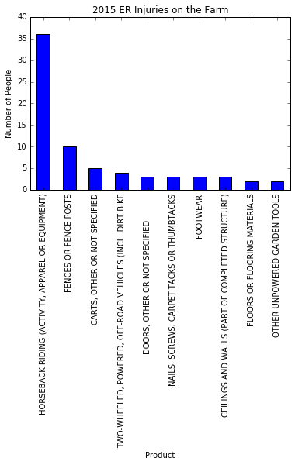
Body Part | Median Age | Count
HEAD | 36 | 58912
FACE | 16 | 31104
LOWER TRUNK | 48 | 30704
FINGER | 26 | 30594
ANKLE | 21 | 20148
UPPER TRUNK | 46 | 19578
KNEE | 27 | 19029
HAND | 27 | 17140
FOOT | 25 | 15961
SHOULDER | 33 | 14874

Slide 15
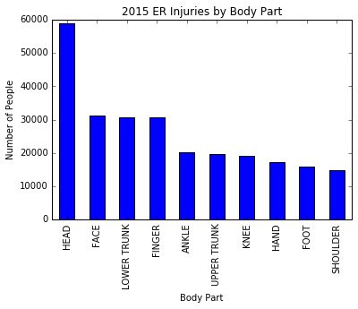
Body Part | Median Age | Count
HEAD | 36 | 58912
FACE | 16 | 31104
LOWER TRUNK | 48 | 30704
FINGER | 26 | 30594
ANKLE | 21 | 20148
UPPER TRUNK | 46 | 19578
KNEE | 27 | 19029
HAND | 27 | 17140
FOOT | 25 | 15961
SHOULDER | 33 | 14874

Slide 16
Farm Activity | Median Age | Count
HORSEBACK RIDING (ACTIVITY, APPAREL OR EQUIPMENT) | 24.5 | 36
FENCES OR FENCE POSTS | 26 | 10
CARTS, OTHER OR NOT SPECIFIED | 10 | 5
TWO-WHEELED, POWERED, OFF-ROAD VEHICLES (INCL. DIRT BIKE | 21.5 | 4
DOORS, OTHER OR NOT SPECIFIED | 15 | 3
NAILS, SCREWS, CARPET TACKS OR THUMBTACKS | 32 | 3
FOOTWEAR | 14 | 3
CEILINGS AND WALLS (PART OF COMPLETED STRUCTURE) | 23 | 3
SPORTS AND RECREATIONAL ACTIVITY, N.E.C. | 20 | 2
LADDERS, OTHER OR NOT SPECIFIED | 11 | 2

Slide 17
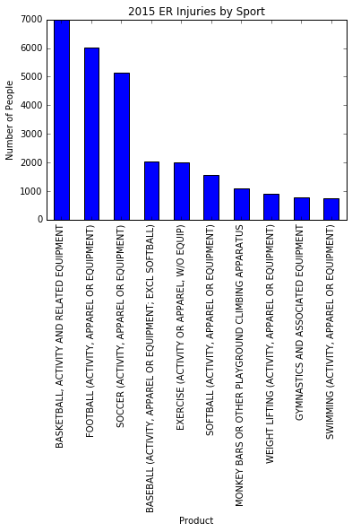
Sport | Median Age | Count
BASKETBALL, ACTIVITY AND RELATED EQUIPMENT | 16 | 6987
FOOTBALL (ACTIVITY, APPAREL OR EQUIPMENT) | 14 | 6034
SOCCER (ACTIVITY, APPAREL OR EQUIPMENT) | 14 | 5127
BASEBALL (ACTIVITY, APPAREL OR EQUIPMENT; EXCL SOFTBALL) | 14 | 2022
EXERCISE (ACTIVITY OR APPAREL, W/O EQUIP) | 34 | 1999
SOFTBALL (ACTIVITY, APPAREL OR EQUIPMENT) | 17 | 1558
MONKEY BARS OR OTHER PLAYGROUND CLIMBING APPARATUS | 6 | 1083
WEIGHT LIFTING (ACTIVITY, APPAREL OR EQUIPMENT) | 29 | 894
GYMNASTICS AND ASSOCIATED EQUIPMENT | 11 | 767
SWIMMING (ACTIVITY, APPAREL OR EQUIPMENT) | 15 | 748

Slide 18
Emotional Injuries

Slide 19
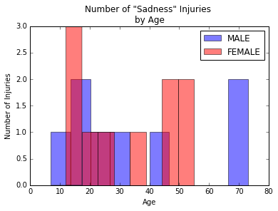
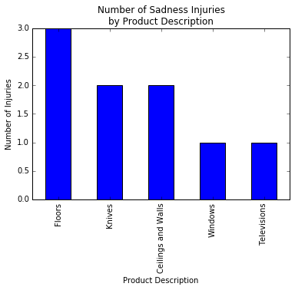
 | Mean age | % of Injuries
FEMALE | 32.0 | 55.6
MALE | 34.8 | 44.4

Slide 20
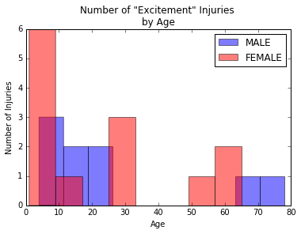
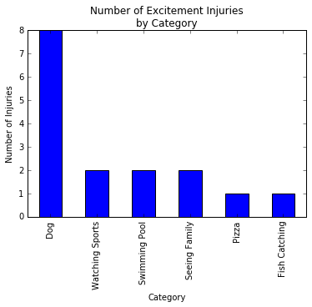
 | Mean age | % of Injuries
FEMALE | 22.5 | 59.1
MALE | 26.2 | 40.9

Slide 21
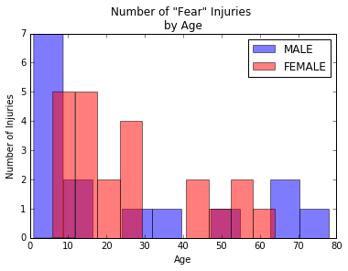
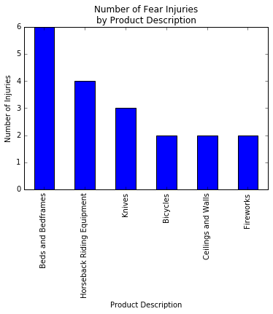
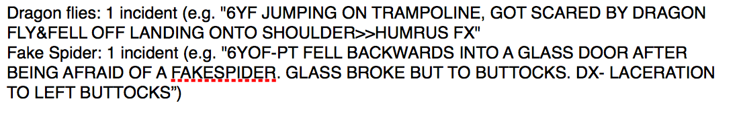
 | Mean age | % of Injuries
FEMALE | 25.6 | 59.5
MALE | 24.7 | 40.5

Slide 22
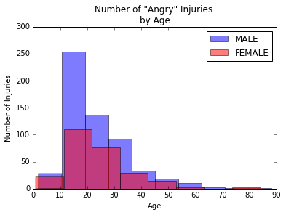
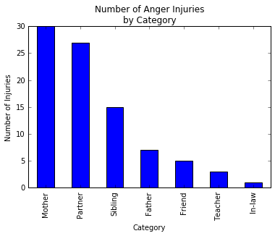
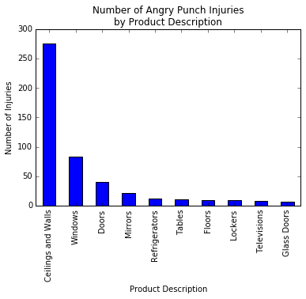
 | Mean age | % of Injuries
FEMALE | 23.8 | 30.9
MALE | 23.3 | 69.1

Slide 23
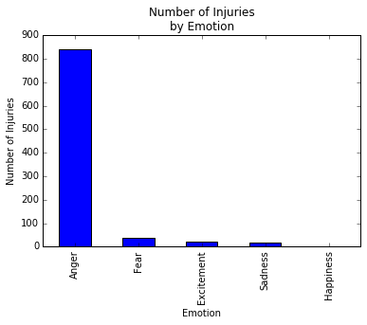

Slide 24
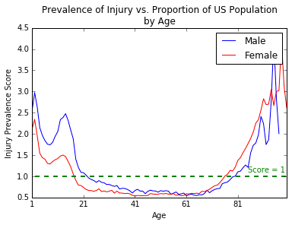

Slide 25
Junk in the Trunk

Slide 26
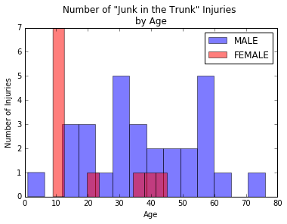
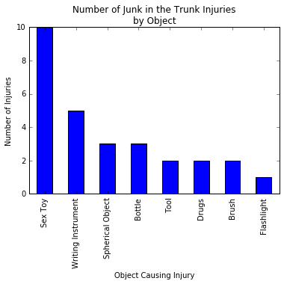
 | Mean age | % of Injuries
FEMALE | 19.7 | 27.5
MALE | 37.9 | 72.5

Slide 27
Recommendations
Stay away from fireworks on July 4th, footballs on Thanksgiving, and knives in general. Also, men help your women out more in the kitchen.
When on a farm, stay away from horses and fences.
If you’re sad, stay away from floors, knives, and walls.
It’s better to be >40 yo. Either you are a more boring person or you have learned to curb your enthusiasm. Either way, you’re a safer person when excited.
Women, don’t be scared because then you’ll get injured. Plus, moms watch out for angry teenage sons.

Slide 28
Recommendations
Yoda was right. Anger really does lead to suffering.
Guys, the only orifice you should be putting things into is your mouth.

Slide 29
The End.

